Slide 1

ReUnite
Helping Unite data to help reunite families

Slide 2
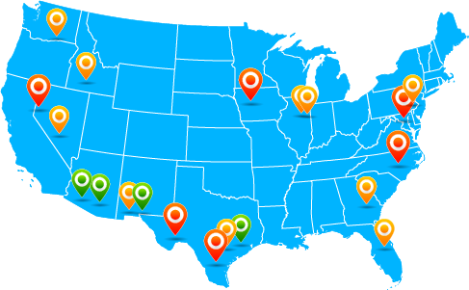
Reunification Challenges
100+ detainment centers across the US with potentially different processes and databases with varying degrees of completeness
Adult centers managed by different funding organizations than children centers which can lead to data sharing issues
Reuniting requires connections to be made between Children’s facilities and Adult facilities.
Data Privacy and confidentiality is primary concern
End Goal: To institute uniform practices across all facilities using a common and secure system that brings data together
Reunite achieves this goal

Slide 3

End Goal
ReUnite Secure Cloud
Single Pane of Glass for all facilities
Uniform processes and workflows built in
Potential Matches leverage data from all centers
Connecting data sources will greatly speed up the process of reuniting children with parents due to the increased efficiency from data sharing
Accurate analytics and numbers on detainees and reunifications for accurate dashboards, metrics, and reports
Lower cost solution to the personnel required to staff a call center.

Slide 4












ReUnite - Overview
ReUnite
Secure Cloud
Secure Facility or
approved center
IPSEC
Detention center
VPN
db1
dbn
db2
IPSEC
VPN
Secured
Database Cluster
Children
Admin
DDoS protection
In place to avoid outage
or loss
All servers implement
Strict firewall
Admin
Parents
Secure Website is
Only accessible through vpn

Slide 5
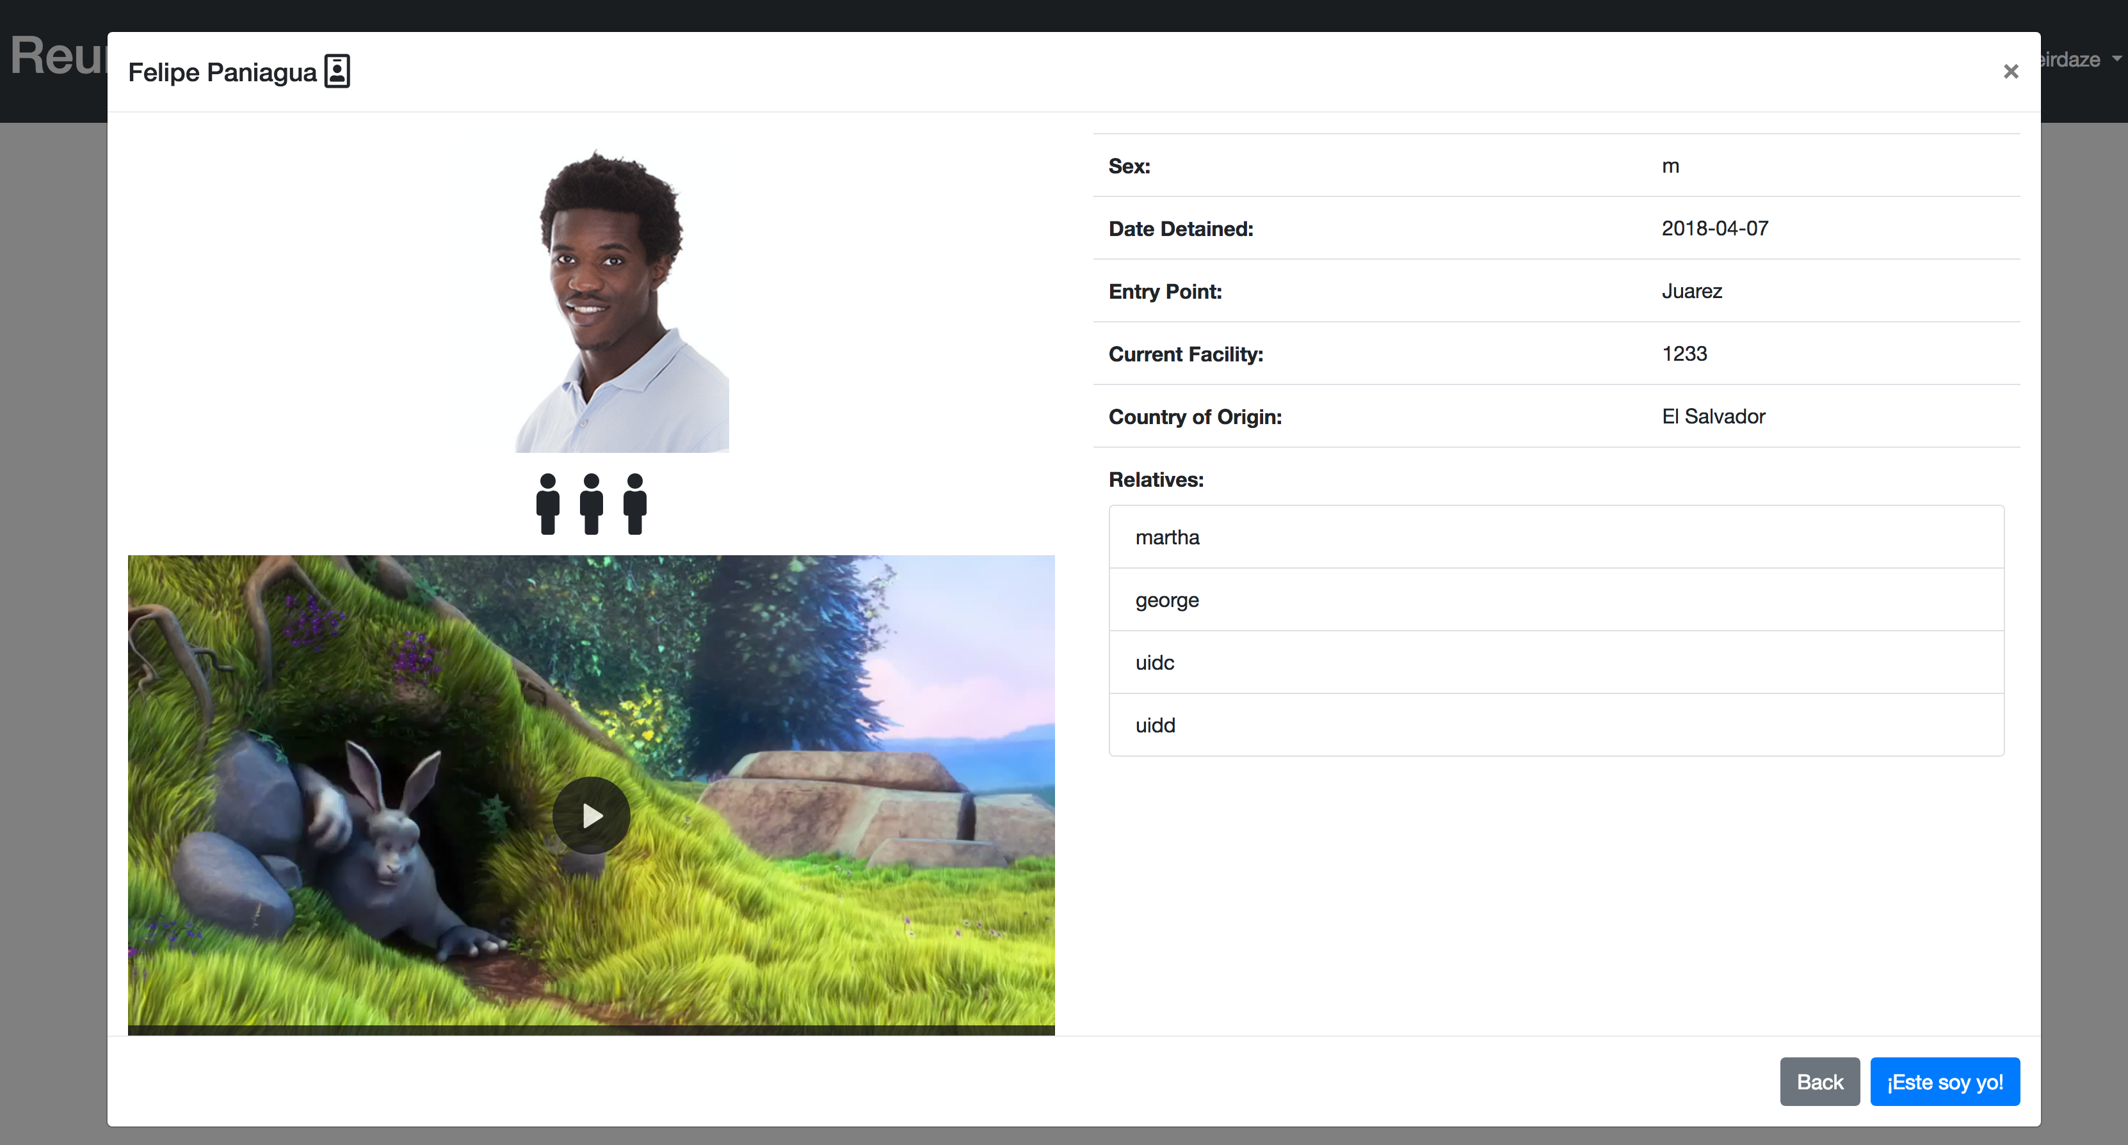
Children searching for parents
Parents register themselves with a photo and a 30sec video message to their kids.
Relatives’ names can be entered to give the child context and assurance that this is their parent.
The child browses or searches for their parent by looking at pictures or using the search engine
They click the blue button at the bottom of their screen to claim their parent.
The ReUnite system then enters a “potential match” and opens up a ticket for the administrators to work through.

Slide 6
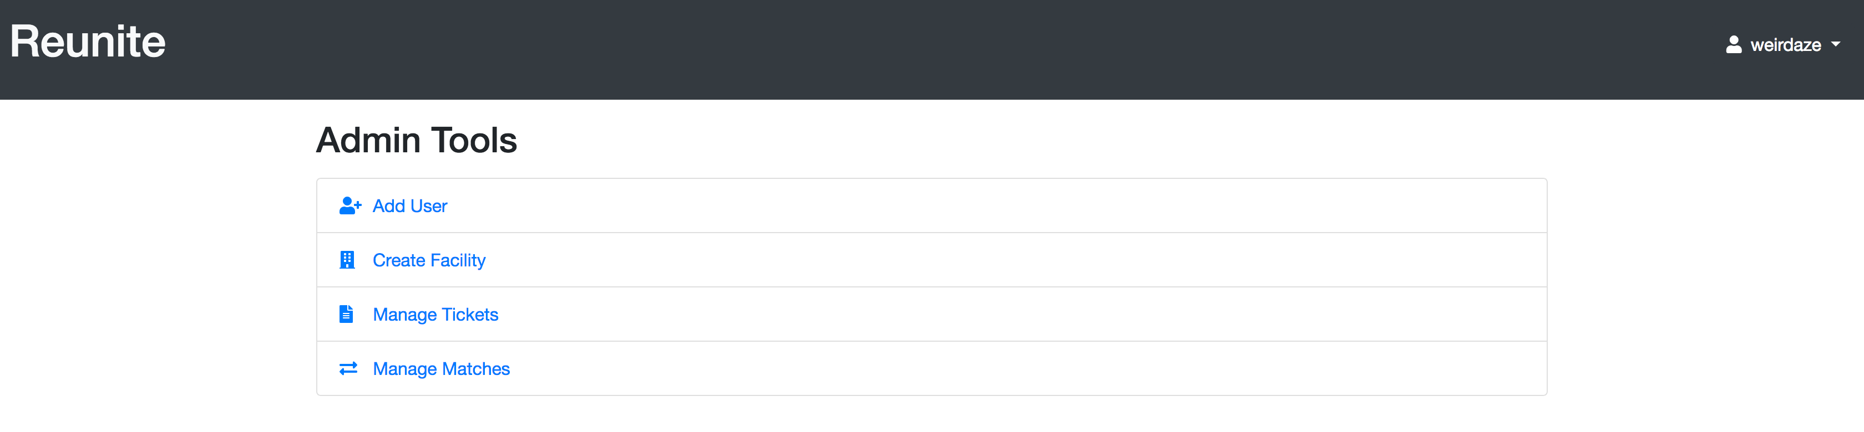
Facility Administrators
Tools are available for administrators to manage ticket queues and find potential matches for verification
Administrators register the children and the adults.
Everything in ReUnite happens under supervision of the admin

Slide 7
Benefits
Central, secure database to unify just the relevant information that will lead to a connection between parent and child.
Common across facilities to ensure information sharing.
Can integrate with their existing databases.
Useful tools available for managing the people, tickets, matches, and facility information
Secure, redundant, and distributed datastore to protect from data breach and data loss
Visual confirmation through photos and videos gives you a more likely match than verbal description
May speed up the process and provide a more streamlined process flow for these facilities to work through the reunification effort.

Slide 8
ReUnite
How it works – High level process
Parents and Children register themselves (or are registered if too young) on a secured tablet or desktop computer at a secured or approved location. (strong security certificates are used)
The registration includes pictures of the parents and children along with a 30 second video message
Upon finding the family member, the child can click “Claim this person” to indicate a familial connection
A ticket is issued but all of the information remains internal to the database.
Only name and other approved info will be displayed
The facilities/Orgs access the central database and start working on the potential matches to reunite families
Verification of the match is completely up to the organization or facility. The application merely provides the data on potential matches and manages ticket work.

Slide 9
ReUnite
What the admin does (Walk-through):
Child or validated parent approaches
Registration information is taken in
Photo is taken
Short 30 second video is taken
(”Hola mijo, te extraño! Ya pronto estaremos juntos!”)
Child is allowed to search for their relatives by name or browse photos
A ticket is issued if a child has found a potential match for their parent
Validation process begins per the facility’s established procedures
NOTE: This is all done in-facility and under supervision

Slide 10
What happens next
If a child finds their family member, they tap or click a button that says “claim”.
This sends the claim to a database where all the claims are held. It also opens a ticket.
An algorithm goes through and identifies instances when people have claimed each other and marks these claims as “potential-matches” along with opening up a ticket for an admin to work through.
This works in the instances where siblings have been separated for some reason.
Once a ticket is generated, the application only has a way of closing the ticket or adding status to it.
The ReUnite system is not responsible for validating a match. Only identifying potential matches.
An admin can also look through the claims database and find claims that may not be matched but they know from experience and they can open up a ticket to work it.

Slide 11
Security
The tablet or PC will have a secure certificate to ensure that it is approved to connect to the VPN
No other device will have access to this vpn outside of the facilities.
Each administrator approved will have a secure username and password to connect to the VPN (think of it as being clocked in)
Each administrator approved will have a secure username and password to log into the application (second level of verification of who’s accessing the system)
The website is tablet/phone/pc friendly (responsive) and is ONLY accessible through the VPN. (Access from an address on the internet or any other address outside of the vpn is strictly disallowed and requests are dropped)
The data displayed as people browse is the minimal amount needed for identification
Images taken by administrators will only be saved on Centerpoint Cloud Servers. No exports allowed unless clearance is provided.
Videos will be moderated by the admins so they do not reveal location of the person

Slide 12
For more information contact us!
If you believe this application could be of use in helping reunite families, we need your help!
It is very important to have the blessing of the facilities and organizations involved. Please email us with referrals, security concerns, suggestions on improvements, and potential connections of influential people that need to become aware this technology exists.
Email us at reunite@centerpointcc.com

